Slide 1


Slide 2

Our software “Mini Weather Forcast” can get the weather(including the temperature, wind scale) of different cities all over the world, and can also give you the choice what clothes you can choose to wear based on the current weather outside.
Analyzing the data, and pick lastest 3 days as specific output(if rain turns red), and a bar graph showing the weather of lastest 7 days.

Slide 3

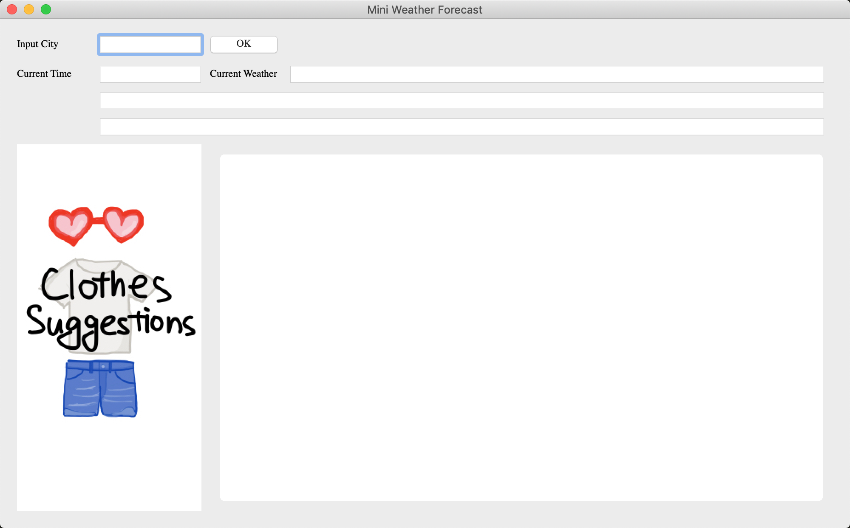
Input
The city your want to check
Data Mining
Crawling data based on the
“Hefeng Weather” API
Analyzing the weather parameters, and build the bar graph. Build our own Clothes Library matching with the weather.
Data Analysis
Using PYQT5 for visualization

Slide 4


Light-weight-clothes-matching
User firendly—easy to operate
Global Location and good accuracy
Making it to moblie application (app) or web-based application
More feature can be added, for example: enlarge our clothes library, activity recommendation.etc.

Slide 5


QTPY5, python3.6, HEFENG Weather API
HEFENG Weather API

